Slide 1
Strategic Management
Dr. Marwa Tarek
7th class
Generating strategies

Slide 2
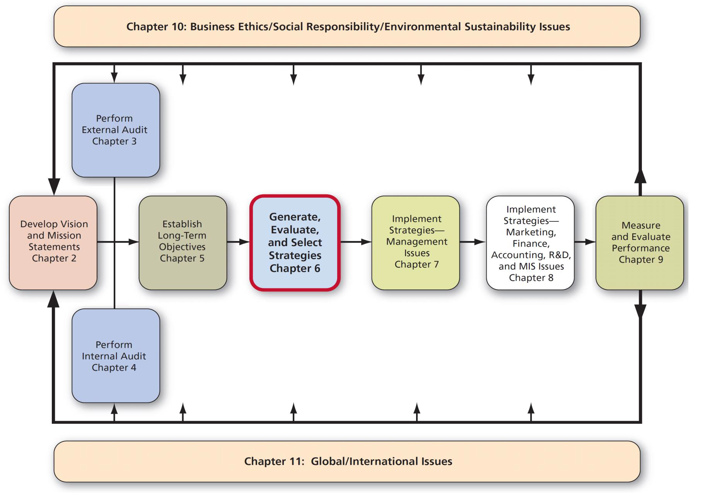
Strategy Analysis & Choice

Slide 3
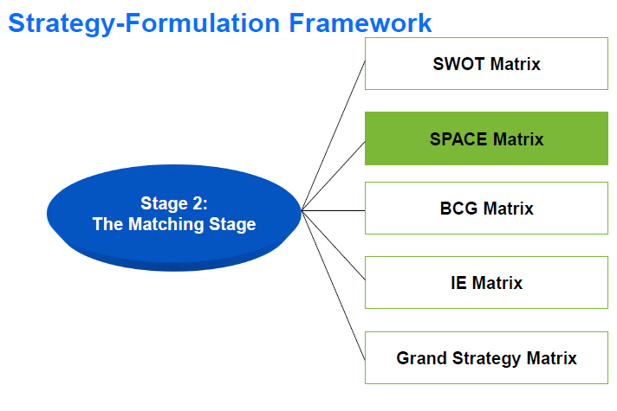

Slide 4
Steps to Develop a SPACE Matrix
If SPACE matching tool is used we have to stick to 2 internal dimensions and 2 external dimensions which is more limited rather than SWOT. They are the most critical dimensions in the audit process.
1. Select a set of variables to define financial position (FP), competitive position (CP), stability position (SP), and industry position (IP)
Internal dimensions
Financial position (FP)
Competitive position (CP)
External dimensions
Environmental Stability position (SP)
Industry position (IP)

Slide 5
Steps to Develop a SPACE Matrix
Internal dimensions
- Financial position (FP)
- Competitive position (CP)
There are many SPACE matrix factors under the internal strategic dimension. These factors analyze a business internal strategic position.
The financial strength factors often come from company accounting. These SPACE matrix factors can include for example return on investment, leverage, turnover, liquidity, working capital, cash flow, and others.
Competitive advantage factors include for example the speed of innovation by the company, market niche position, customer loyalty, product quality and market share.
External dimensions
Environmental Stability position (SP)
Industry position (IP)
Every business is also affected by the environment in which it operates. SPACE matrix factors related to business external strategic dimension are for example overall economic condition, GDP growth, inflation, price elasticity, technology, barriers to entry, competitive pressures, industry growth potential, and others.

Slide 6
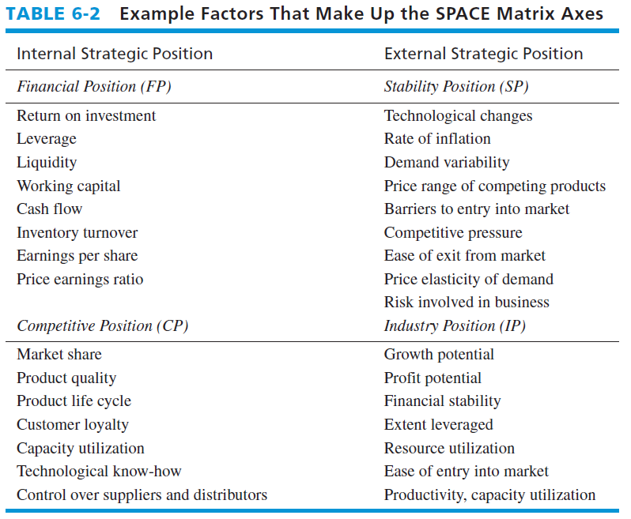
Factors That Make Up the SPACE Matrix Axes

Slide 7
The following items should be considered when assessing Financial Strength:
Return on investment (low to high)
Leverage (debt to equity ratio) (inbalanced to balanced)
Liquidity (access to quick money when needed) (inbalanced to solid)
Capital required versus capital available) (high to low)
Cash flow (low to high)
Ease of exit from market (difficult to easy)
Risk involved in the business (much to little)
Inventory turnover (slow to fast)
Use of economies of scale and experience (low to high)

Slide 8
The following items should be considered when assessing Competitive Advantage:
Market share (small to large)
Product quality (inferior to superior)
Product life cycle (late to early)
Product replacement cycle (variable to fixed)
Customer loyalty (low to high)
Competition’s capacity utilization (low to high)
Technological know-how (low to high)
Speed of new product introductions (slow to fast)

Slide 9
The following items should be considered when assessing Industry Attractiveness :
Growth potential (low to high)
Profit potential (low to high)
Financial stability (low to high)
Technological know-how (simple to complex)
Resource utilization (inefficient to efficient)
Capital intensity (low to high)
Ease of entry into the market (easy to difficult)
Productivity; capacity utilisation (low to high)

Slide 10
The following items should be considered when assessing Environmental Stability:
Technological changes
Rate of inflation
Demand variability
Price range of competing products
Barriers to entry into market
Competitive barriers
Price elasticity of demand

Slide 11
Steps to Develop a SPACE Matrix
2. Assign a numerical value ranging from +1 (worst) to +7 (best) to each of the variables that make up the FP and IP dimensions.
3. Assign a numerical value ranging from –1 (best) to –7 (worst) to each of the variables that make up the SP and CP dimensions.

Slide 12
Steps to Develop a SPACE Matrix
3. Compute an average score for FP, CP, IP, and SP. (Total numerical values divided by the number of chosen elements of each dimension).
4. Plot the average scores for FP, IP, SP, and CP on the appropriate axis in the SPACE Matrix.
5. Add the two scores on the x-axis and plot the resultant point on X. Add the two scores on the y-axis and plot the resultant point on Y. Plot the intersection of the new xy point.

Slide 13
Stage 2: The Matching Stage
SPACE Matrix….Matching tool
Strategic Position & Action Evaluation Matrix
Aggressive
Conservative
Defensive
Competitive
.

Slide 14
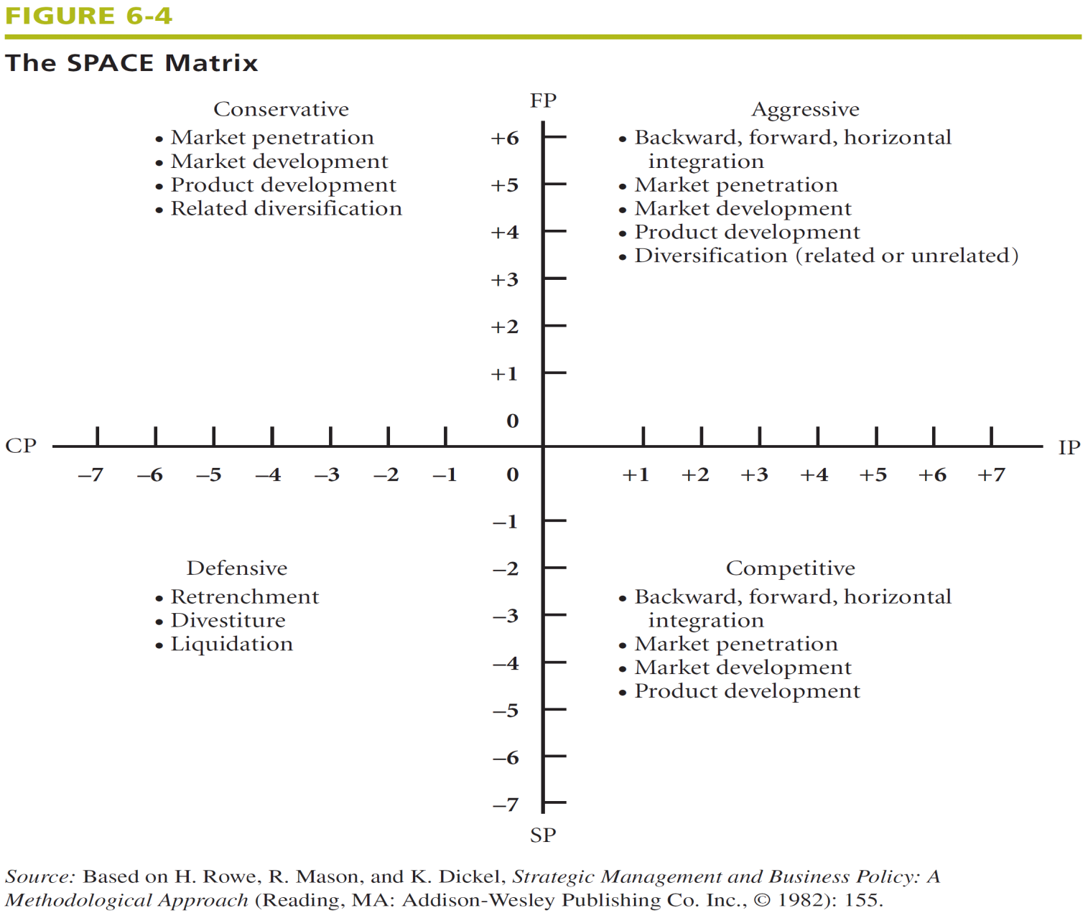
SPACE Matrix

Slide 15
Steps to Develop a SPACE Matrix
6. Draw a directional vector from the origin of the SPACE Matrix through the new intersection point.
This vector reveals the type of strategies recommended for the organization: aggressive, competitive, defensive, or conservative

Slide 16
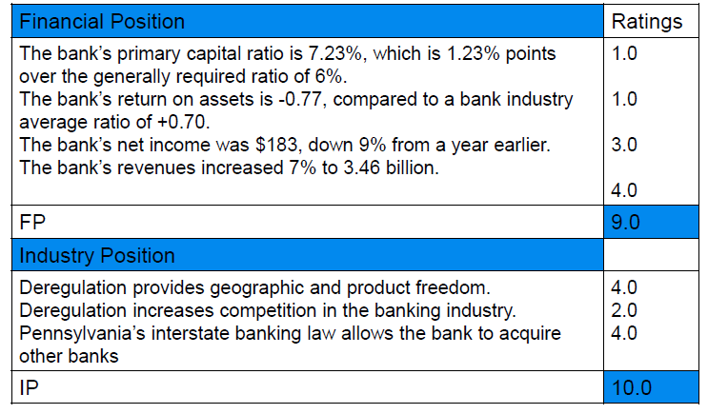
A SPACE Matrix for a Bank

Slide 17
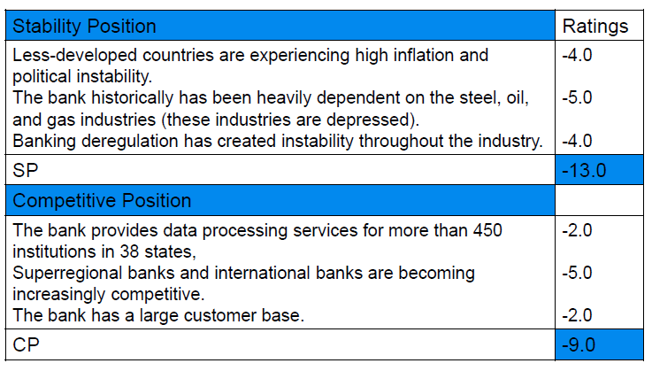
A SPACE Matrix for a Bank

Slide 18
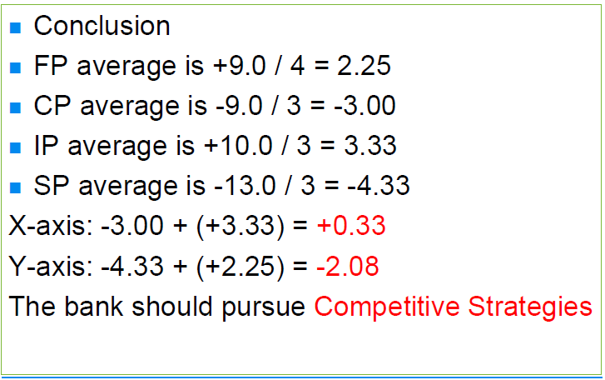
A SPACE Matrix for a Bank

Slide 19

SPACE Matrix

